Slide 1
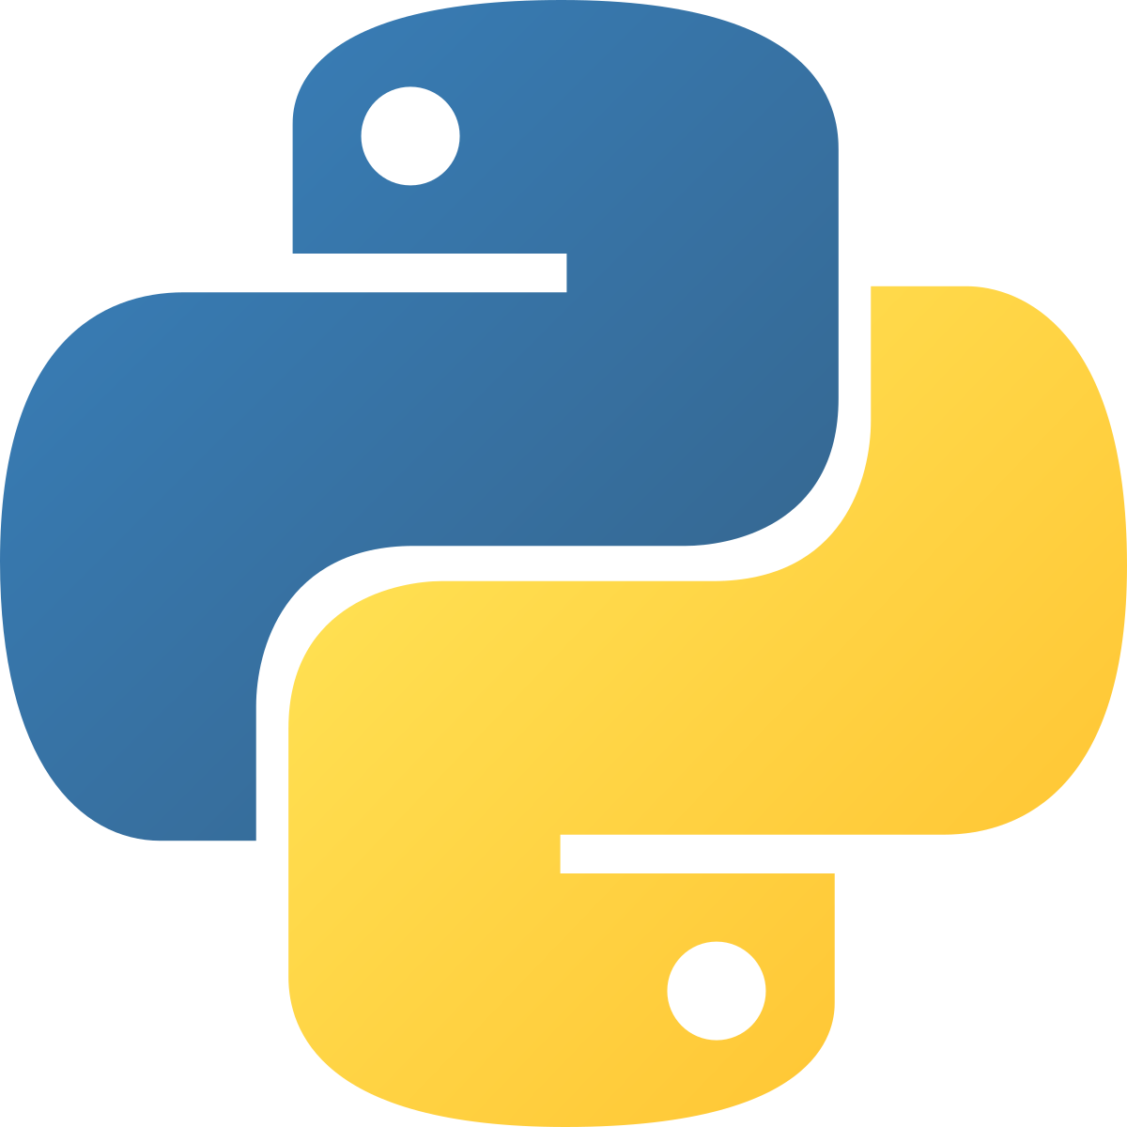



Top Interview Questions
Over the past few months, I have attended more than 50+ interviews across various companies. Based on this experience, I have curated a list of the most frequently asked Python questions, which I will be covering in this course.

Slide 2
1. Difference Between List and Tuple
LIST
Lists are mutable
List is a container to contain different types of objects and is used to iterate objects.
Syntax Of List
list = ['a', 'b', 'c', 1,2,3]
List iteration is slower
Lists consume more memory
Operations like insertion and deletion are better performed.
TUPLE
Tuples are immutable
Tuple is also similar to list but contains immutable objects.
Syntax Of Tuple
tuples = ('a', 'b', 'c', 1, 2)
Tuple processing is faster than List.
Tuple consume less memory
Elements can be accessed better.

Slide 3
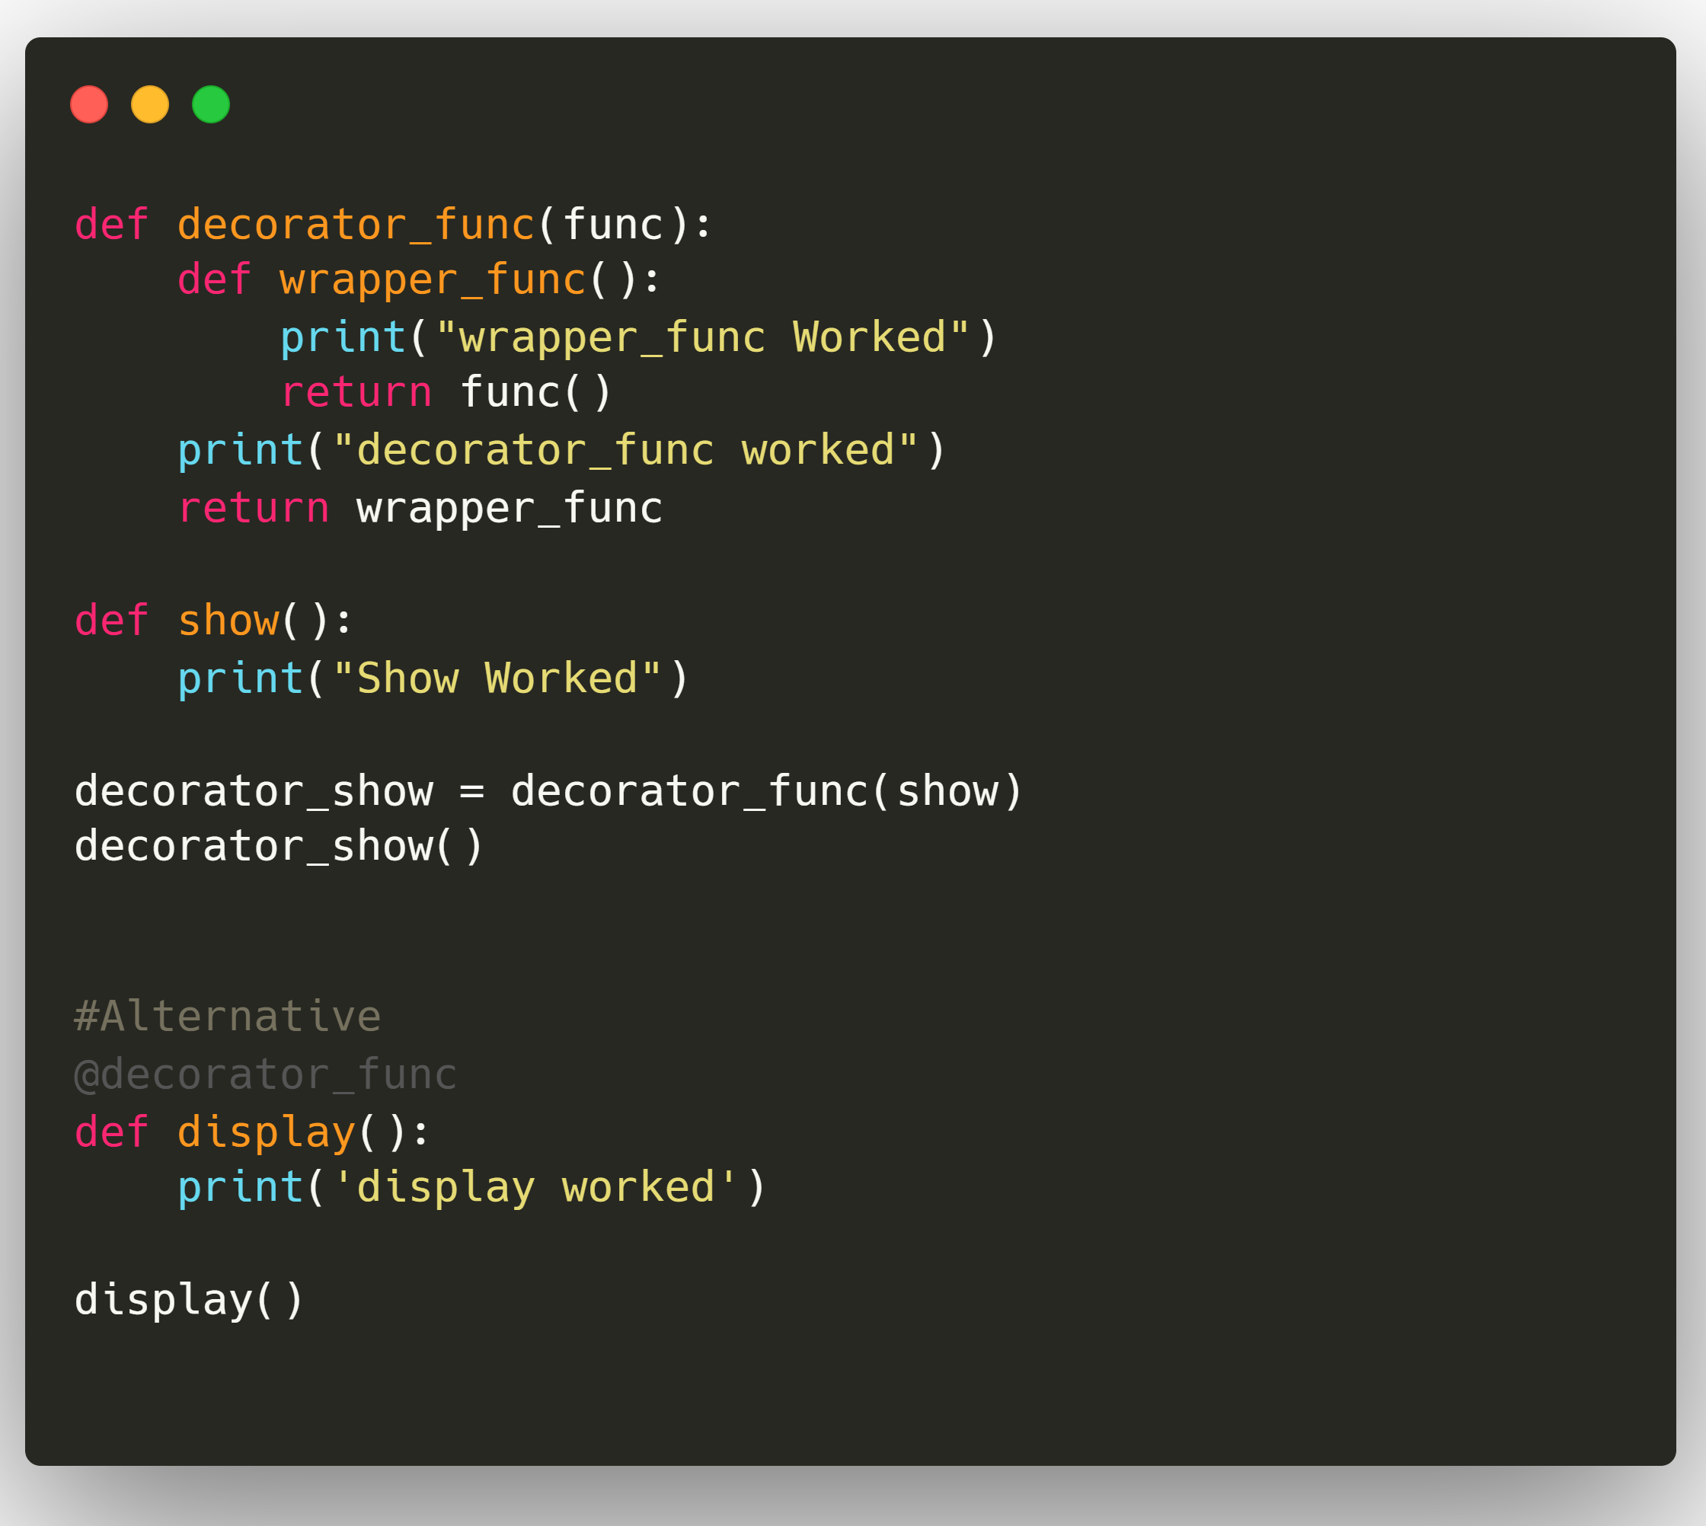
2. What is a Decorator ?
A Decorator is just a function that takes another function as an argument, add some kind of functionality and then returns another function.
All of this without altering the source code of the original function that you passed in.
Output:
decorator_func worked
wrapper_func Worked
Show Worked
decorator_func worked
wrapper_func Worked
display worked

Slide 4
3. Difference Between List and Dict Comprehension
LIST COMPREHENSION
Syntax:
[expression for item in iterable if conditional]
Example:
Common Way:
l = []
for i in range(10):
if i%2:
l.append(i)
print(l)
Using List Comprehension:
ls = [i for i in range(10) if i%2]
print(ls)
Output:
[1, 3, 5, 7, 9]
DICTIONARY COMPREHENSION
Syntax :
{key:value for (key,value) in iterable if conditional}
Example:
Common Way:
d = {}
for i in range(1,10):
sqr = i*i
d[i] = i*i
print(d)
Using Dict Comprehension:
d1={n:n*n for n in range(1,10)}
print (d1)
Output:
{1: 1, 2: 4, 3: 9, 4: 16, 5: 25, 6: 36, 7: 49, 8: 64, 9: 81}

Slide 5
4. How Memeory Managed in Python ?
Memory management in Python involves a private heap containing all Python objects and data structures. Interpreter takes care of Python heap and that the programmer has no access to it.
The allocation of heap space for Python objects is done by Python memory manager. The core API of Python provides some tools for the programmer to code reliable and more robust program.
Python also has a build-in garbage collector which recycles all the unused memory. When an object is no longer referenced by the program, the heap space it occupies can be freed. The garbage collector determines objects which are no longer referenced by the program frees the occupied memory and make it available to the heap space.
The gc module defines functions to enable /disable garbage collector:
gc.enable() -Enables automatic garbage collection.
gc.disable() - Disables automatic garbage collection.

Slide 6
5. Difference Between Generators and Iterators
GENERATOR
Generators are iterators which can execute only once.
Generator uses “yield” keyword.
Generators are mostly used in loops to generate an iterator by returning all the values in the loop without affecting the iteration of the loop.
Every generator is an iterator.
EXAMPLE:
def sqr(n):
for i in range(1, n+1):
yield i*i
a = sqr(3)
print(next(a))
print(next(a))
print(next(a))
Output:
1
4
9
ITERATOR
An iterator is an object which contains a countable number of values and it is used to iterate over iterable objects like list, tuples, sets, etc.
Iterators are used mostly to iterate or convert other objects to an iterator using iter() function.
Iterator uses iter() and next() functions.
Every iterator is not a generator.
Example:
iter_list = iter(['A', 'B', 'C'])
print(next(iter_list))
print(next(iter_list))
print(next(iter_list))
Output:
A
B
C

Slide 7
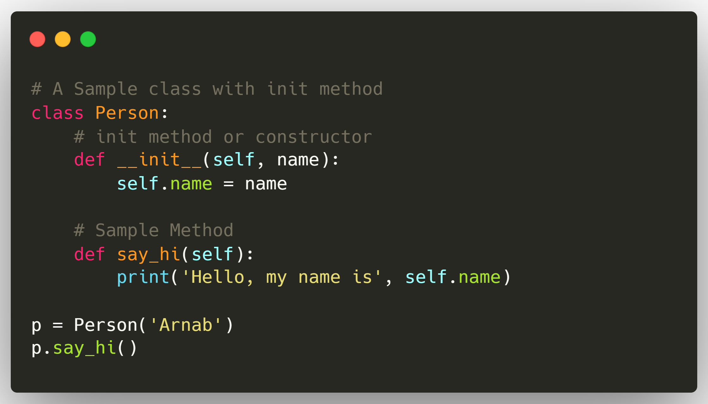
6. What is ‘init’ Keyword in Python ?
__init__() function
__init__.py file
The __init__ method is similar to constructors in C++ and Java. Constructors are used to initialize the object’s state.
The __init__.py file lets the Python interpreter know that a directory contains code for a Python module. It can be blank. Without one, you cannot import modules from another folder into your project.
The role of the __init__.py file is similar to the __init__ function in a Python class. The file essentially the constructor of your package or directory without it being called such. It sets up how packages or functions will be imported into your other files.
Output:
Hello, my name is Arnab

Slide 8
7. Difference Between Modules and Packages in Python
MODULE
The module is a simple Python file that contains collections of functions and global variables and with having a .py extension file. It is an executable file and to organize all the modules we have the concept called Package in Python.
A module is a single file (or files) that are imported under one import and used. E.g.
import my_module
PACKAGE
The package is a simple directory having collections of modules. This directory contains Python modules and also having __init__.py file by which the interpreter interprets it as a Package. The package is simply a namespace. The package also contains sub-packages inside it.
A package is a collection of modules in directories that give a package hierarchy.
from my_package.abc import a

Slide 9
8. Difference Between Range and Xrange?
Parameters | Range() | Xrange()
Return type | It returns a list of integers. | It returns a generator object.
Memory Consumption | Since range() returns a list of elements, it takes more memory. | In comparison to range(), it takes less memory.
Speed | Its execution speed is slower. | Its execution speed is faster.
Python Version | Python 2, Python 3 | xrange no longer exists.
Operations | Since it returns a list, all kinds of arithmetic operations can be performed. | Such operations cannot be performed on xrange().

Slide 10
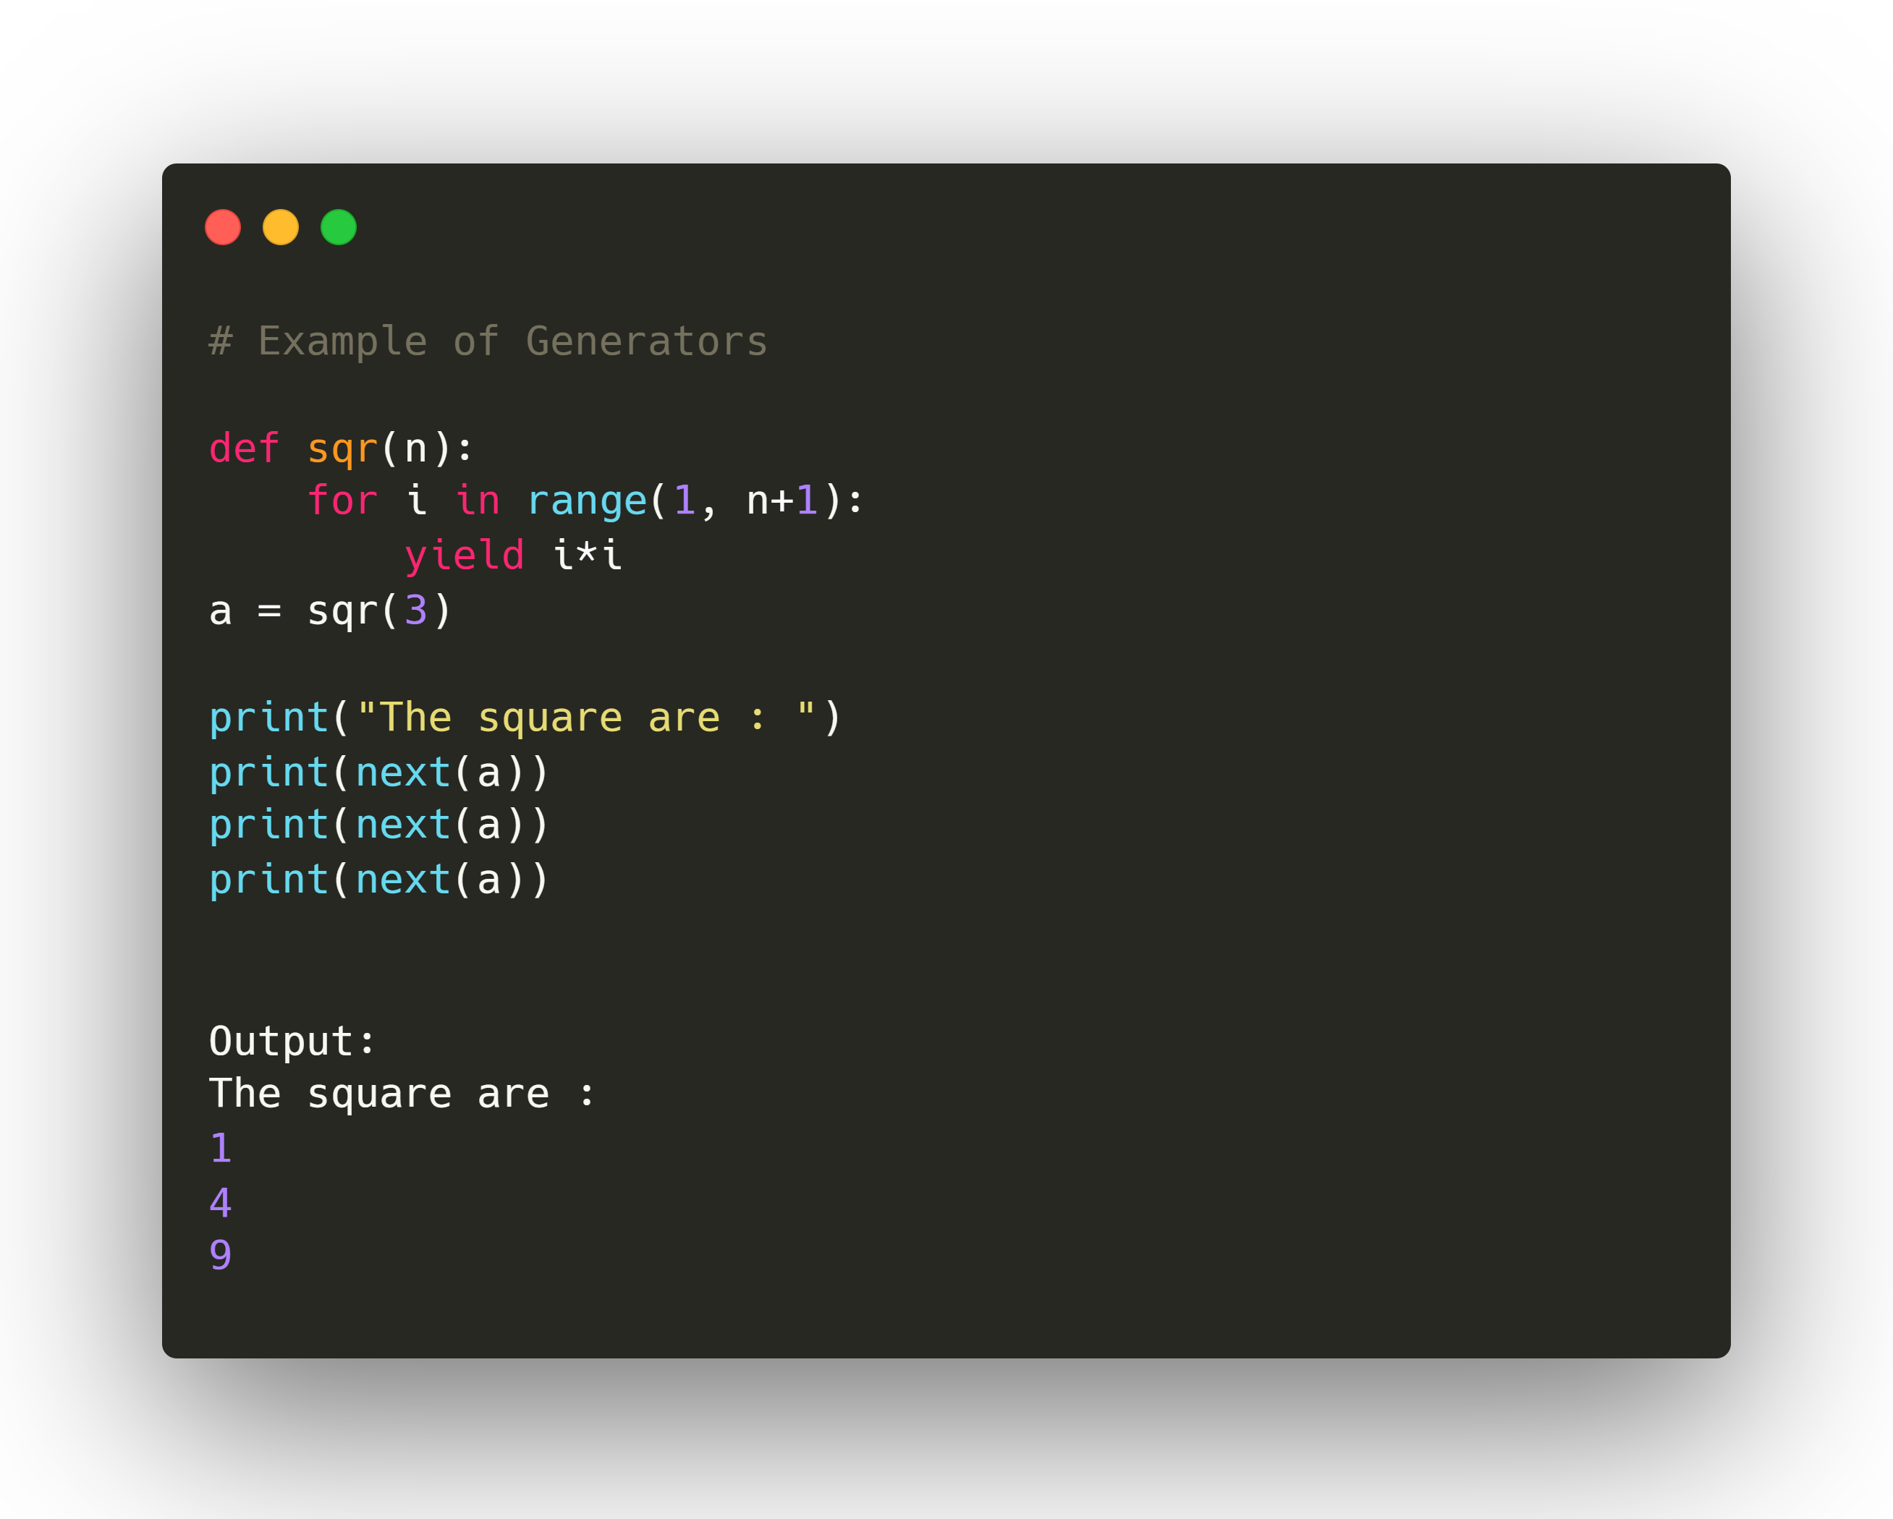
9. What are Generators ?
Generators are iterators which can execute only once.
Every generator is an iterator.
Generator uses “yield” keyword.
Generators are mostly used in loops to generate an iterator by returning all the values in the loop without affecting the iteration of the loop

Slide 11
10. What are in-built Data Types in Python?
A first fundamental distinction that Python makes on data is about whether or not the value of an object changes.
If the value can change, the object is called mutable, while if the value cannot change, the object is called immutable.
DataType | Mutable Or Immutable?
Boolean (bool) | Immutable
Integer (int) | Immutable
Float | Immutable
String (str) | Immutable
tuple | Immutable
frozenset | Immutable
list | Mutable
set | Mutable
dict | Mutable

Slide 12
11. Explain Ternary Operatory in Python ?
The syntax for the Python ternary statement is as follows:
[if_true] if [expression] else [if_false]
Ternary Operator Example:
age = 25
discount = 5 if age < 65 else 10
print(discount)

Slide 13
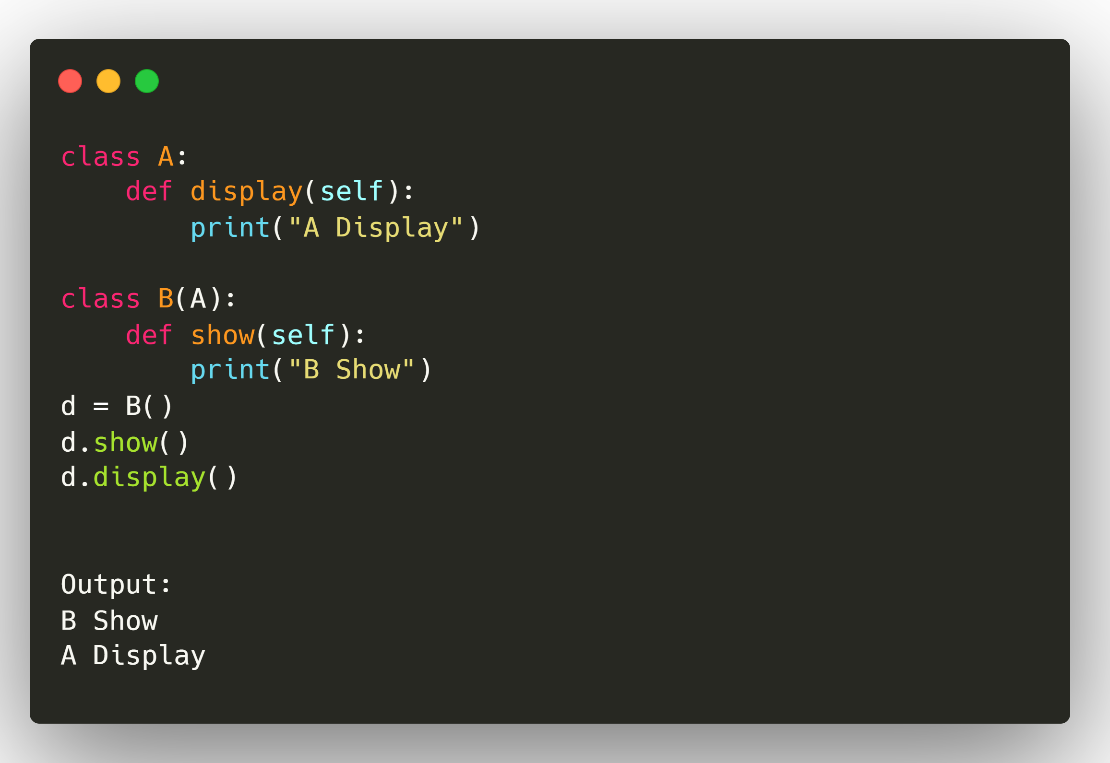
12. What is Inheritance in Python ?
In inheritance, the child class acquires the properties and can access all the data members and functions defined in the parent class. A child class can also provide its specific implementation to the functions of the parent class.
In python, a derived class can inherit base class by just mentioning the base in the bracket after the derived class name.
Class A(B):

Slide 14
13. Difference Between Local and Global Variable in Python
Local Variable | Global Variable
It is declared inside a function. | It is declared outside the function.
If it is not initialized, a garbage value is stored | If it is not initialized zero is stored as default.
It is created when the function starts execution and lost when the functions terminate. | It is created before the program’s global execution starts and lost when the program terminates.
Data sharing is not possible as data of the local variable can be accessed by only one function. | Data sharing is possible as multiple functions can access the same global variable.
Parameters passing is required for local variables to access the value in other function | Parameters passing is not necessary for a global variable as it is visible throughout the program
When the value of the local variable is modified in one function, the changes are not visible in another function. | When the value of the global variable is modified in one function changes are visible in the rest of the program.
Local variables can be accessed with the help of statements, inside a function in which they are declared. | You can access global variables by any statement in the program.
It is stored on the stack unless specified. | It is stored on a fixed location decided by the compiler.

Slide 15
14. Explain Break, Continue and Pass Statement
A break statement, when used inside the loop, will terminate the loop and exit. If used inside nested loops, it will break out from the current loop.
A continue statement will stop the current execution when used inside a loop, and the control will go back to the start of the loop.
A pass statement is a null statement. When the Python interpreter comes across the pass statement, it does nothing and is ignored.
Break Statement Example
for i in range(10):
if i == 7:
break
print( i, end = ",")
Output:
0,1,2,3,4,5,6,
Continue Statement Example
for i in range(10):
if i == 7:
continue
print( i, end = ",")
Output:
0,1,2,3,4,5,6,8,9,
Pass Statement Example
def my_func():
print('pass inside function')
pass
my_func()
Output:
pass inside function

Slide 16
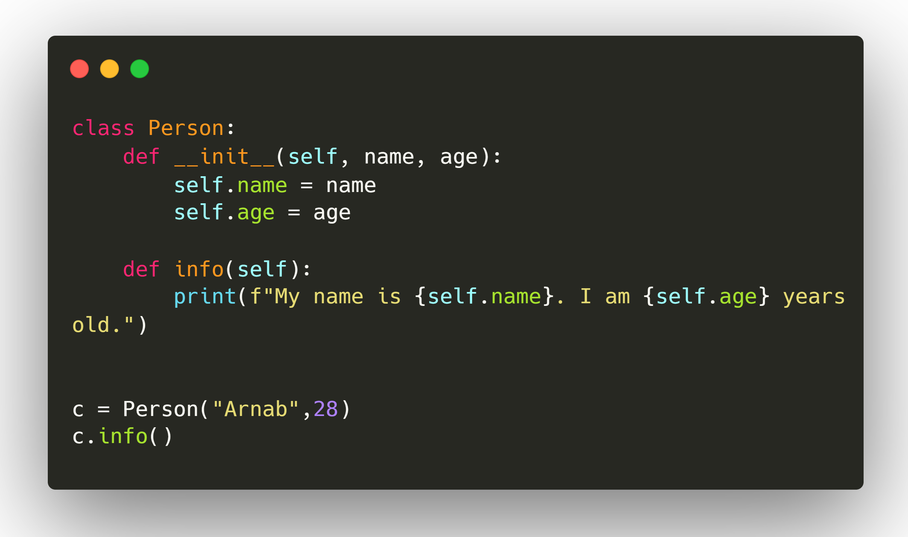
15. What is ‘self’ Keyword in Python ?
The ‘self’ parameter is a reference to the current instance of the class, and is used to access variables that belongs to the class.
Output:
My name is Arnab. I am 28 years old.

Slide 17
16. Difference between Pickling and Unpickling ?
Pickling:
In python, the pickle module accepts any Python object, transforms it into a string representation, and dumps it into a file by using the dump function. This process is known as pickling. The function used for this process is pickle.dump()
Unpickling:
The process of retrieving the original python object from the stored string representation is called unpickling.
The function used for this process is pickle.load()
Pickling, also called serialization, involves converting a Python object into a series of bytes which can be written out to a file.
Unpicking, or de-serialization, does the opposite it converts a series of bytes into the Python object it represents.

Slide 18
17. Explain Type Conversion in Python ?
int() - Converts any data type into an integer.
float() - Returns A floating point number from a number or string
oct() - Returns its octal representation in a string format.
hex() - Convert the integer into a suitable hexadecimal form for the number of the integer.
ord() - Returns the integer of the Unicode point of the character in the Unicode case or the byte value in the case of an 8-bit argument.
chr(number) - Returns the character (string) from the integer (represents unicode code point of the character).
eval() - Parses the expression argument and evaluates it as a python expression.
str() - Convert a value (integer or float) into a string.
repr() - Returns the string representation of the value passed to eval function by default. For the custom class object, it returns a string enclosed in angle brackets that contains the name and address of the object by default.

Slide 19
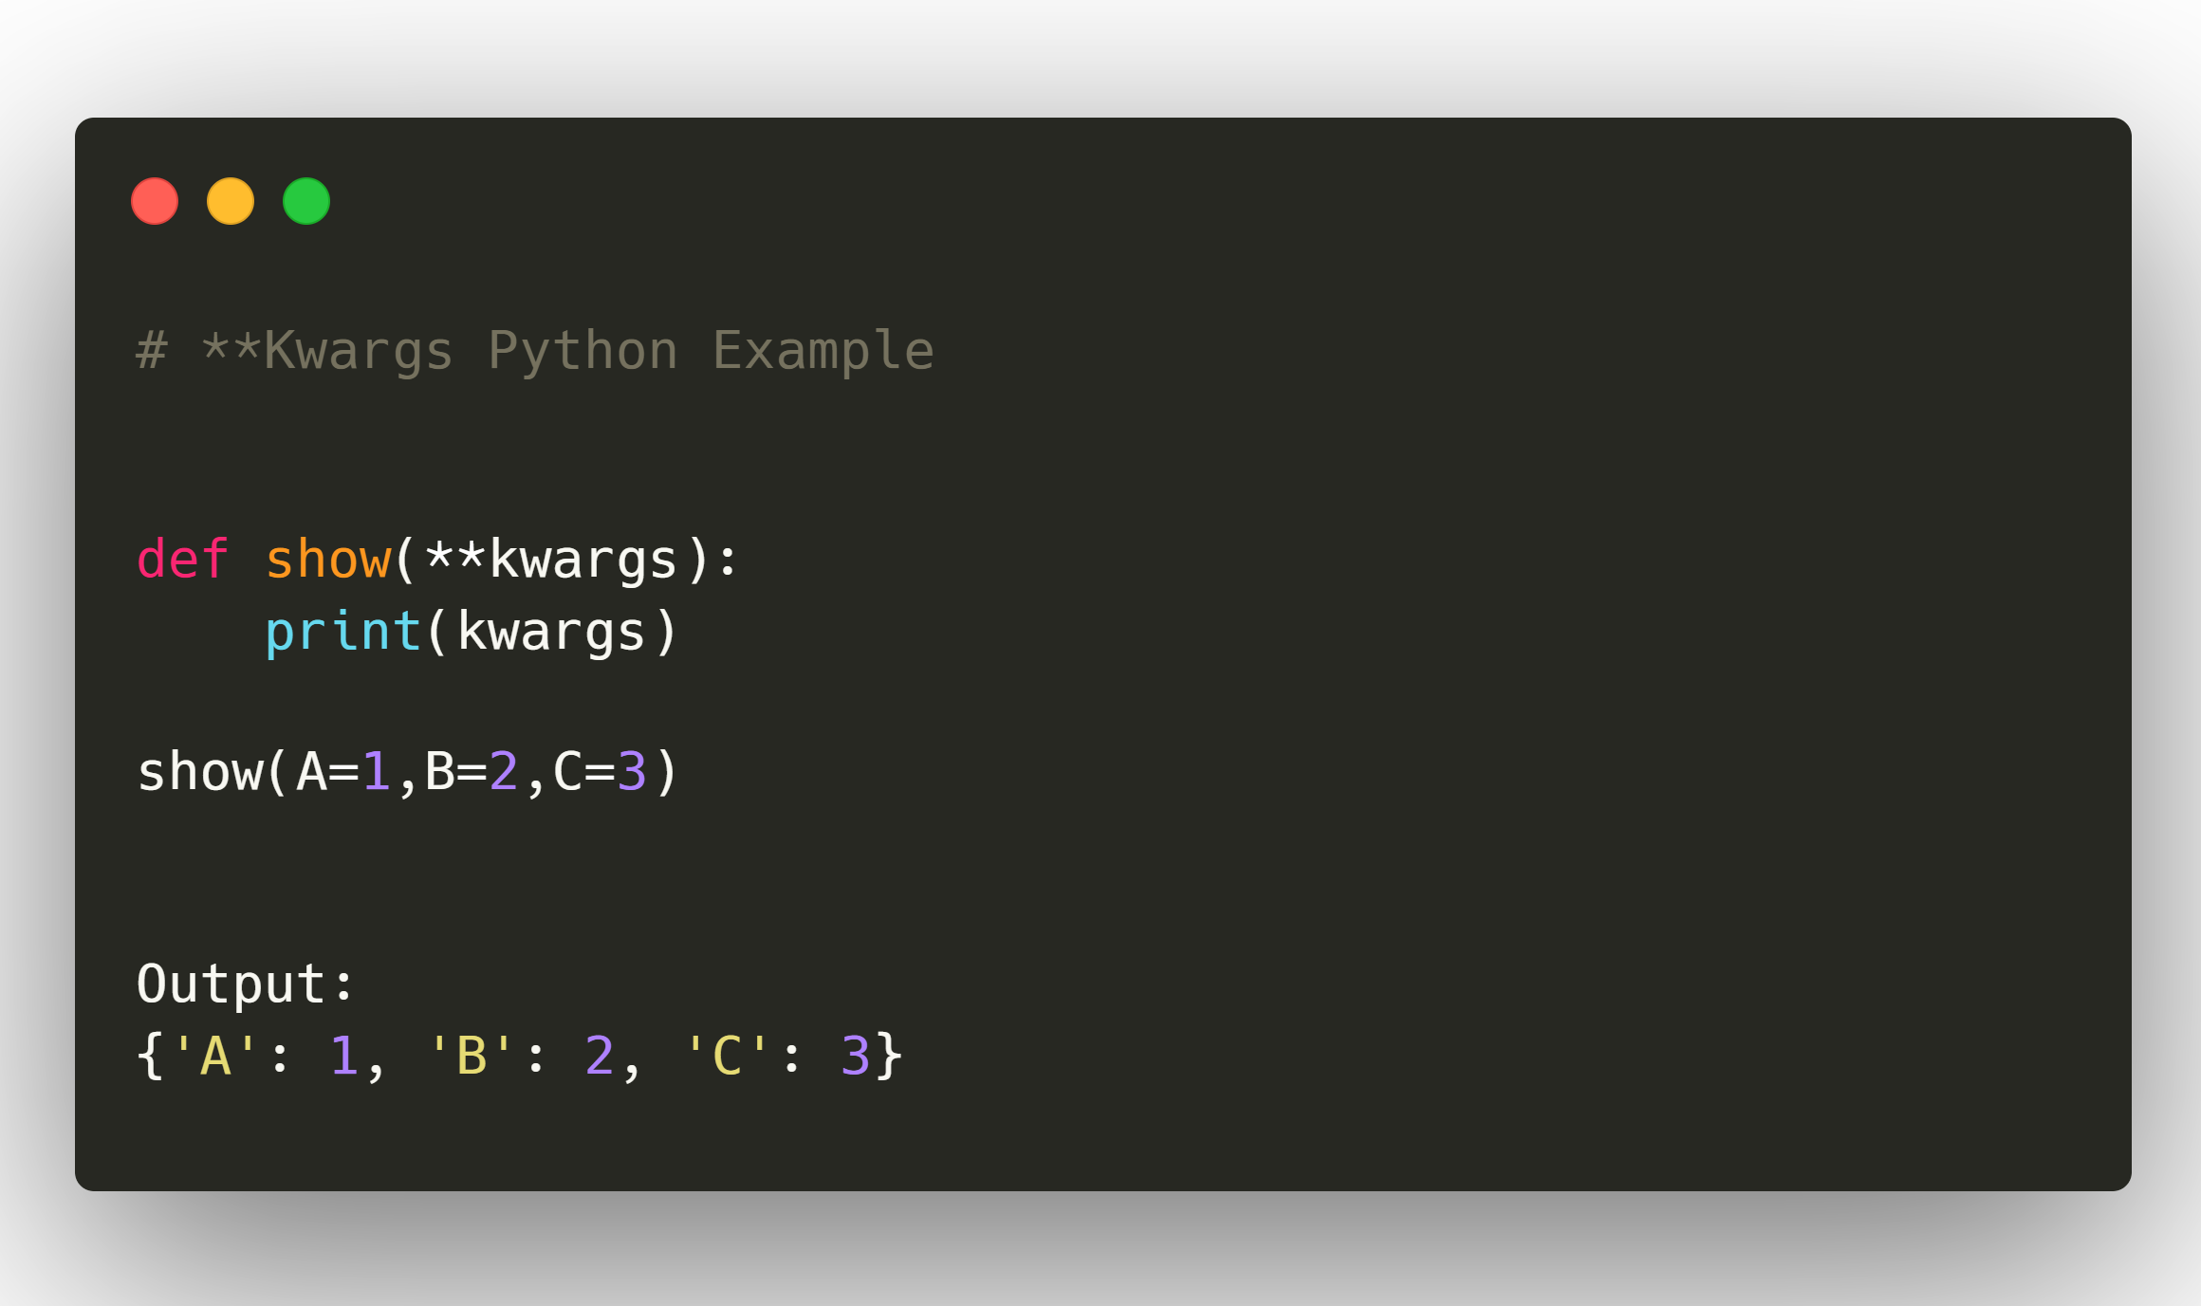
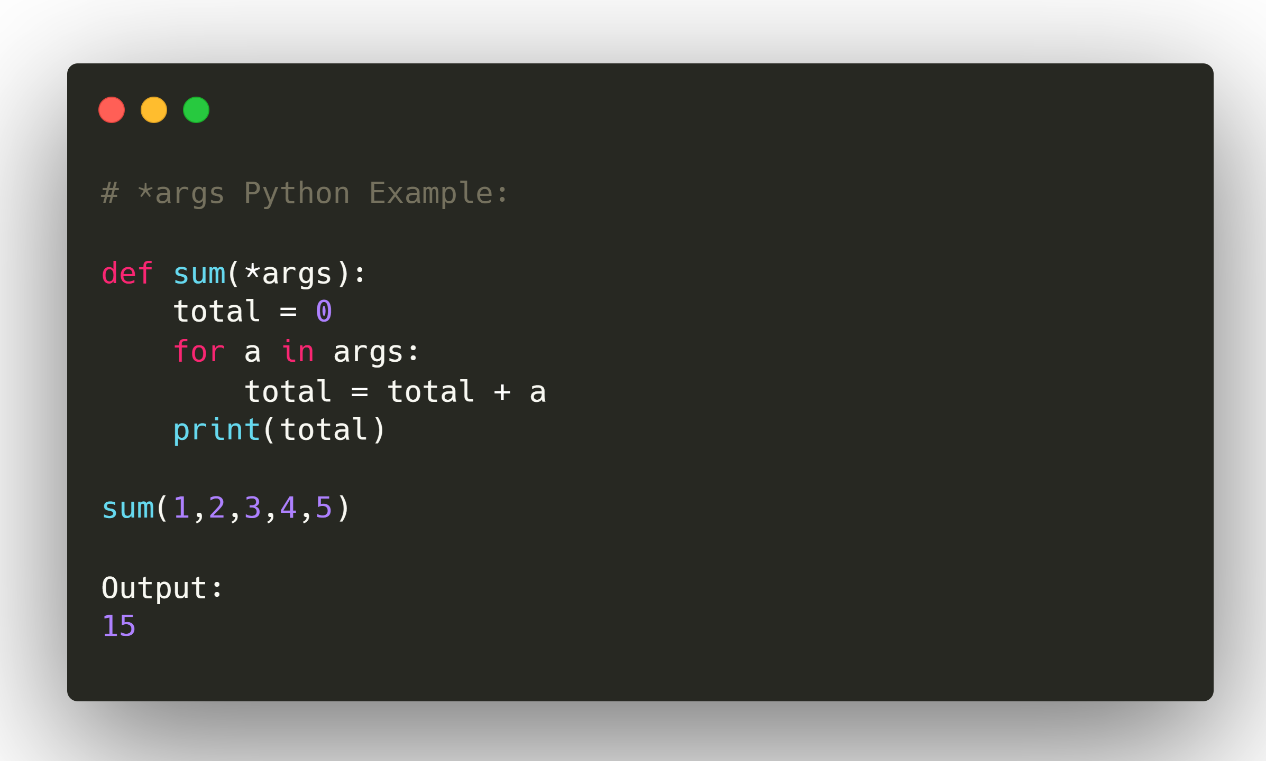
18. What does *args and **kwargs mean ?
When you are not clear how many arguments you need to pass to a particular function, then we use *args and **kwargs.
The *args keyword represents a varied number of arguments. It is used to add together the values of multiple arguments
The **kwargs keyword represents an arbitrary number of arguments that are passed to a function. **kwargs keywords are stored in a dictionary. You can access each item by referring to the keyword you associated with an argument when you passed the argument.

Slide 20
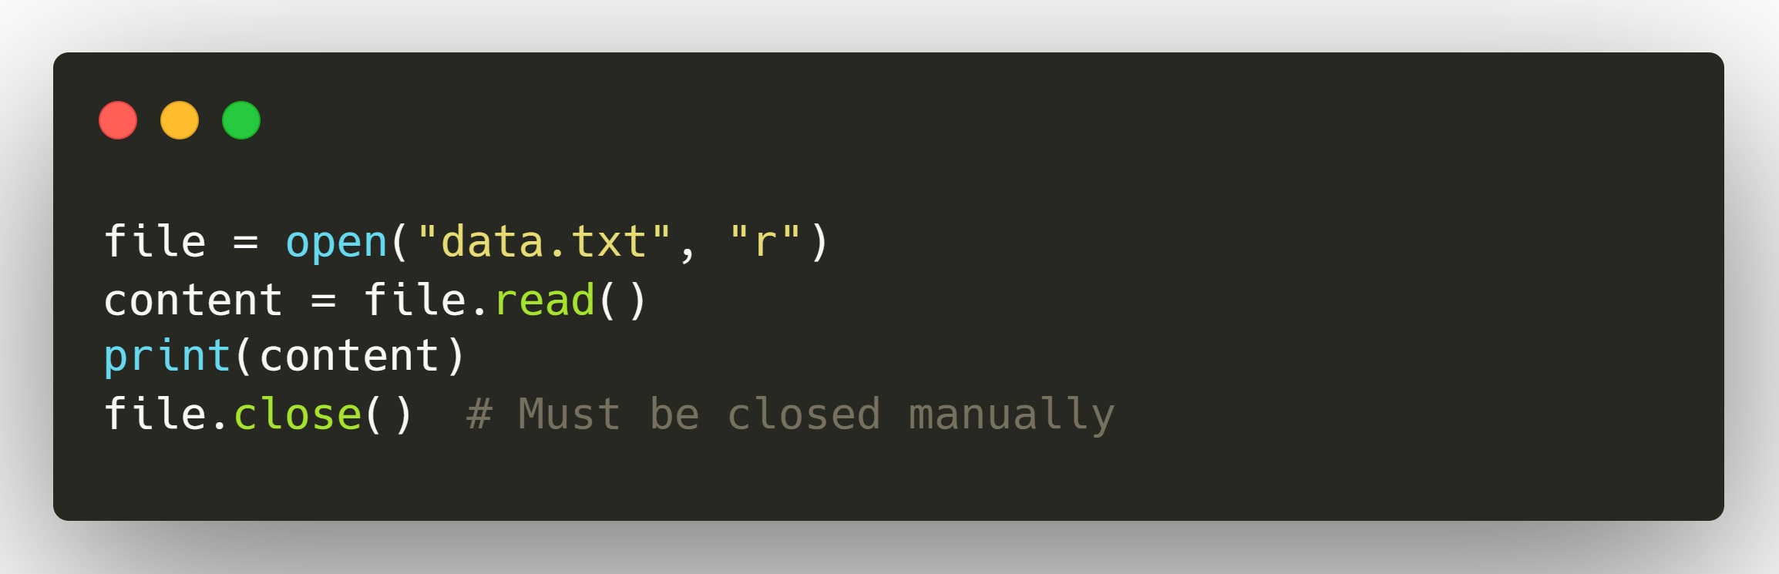
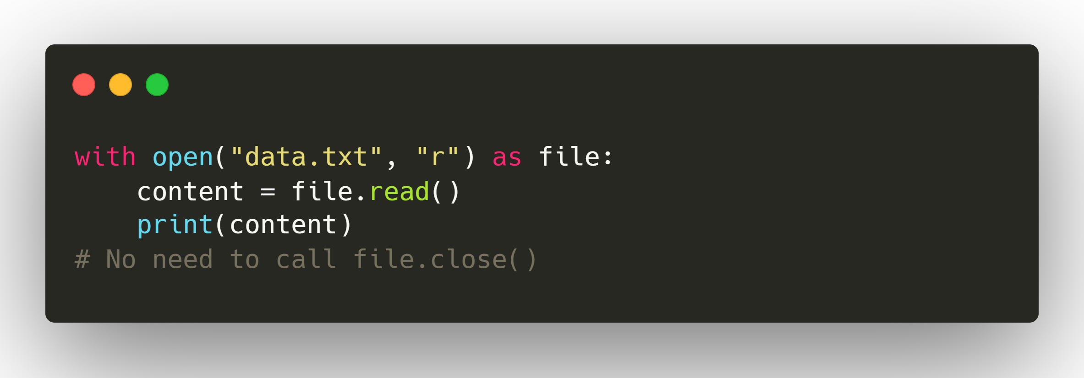
19. What is “open” and “with” statement in Python ?
1. open function
The open() function is used to open a file and return a file object.
2. with statement
The with statement is a context manager that automatically handles setup and cleanup tasks—in this case, opening and closing files.
Both Statements are used in case of file handling.
With the “With” statement, you get better syntax and exceptions handling.

Slide 21
20. Different ways to read and write in a file in Python ?
Syntax of Python open file function:
file_object = open("filename", "mode")
Read Only (‘r’) : Open text file for reading. The handle is positioned at the beginning of the file. If the file does not exists, raises I/O error. This is also the default mode in which file is opened.
Read and Write (‘r+’) : Open the file for reading and writing. The handle is positioned at the beginning of the file. Raises I/O error if the file does not exists.
Write Only (‘w’) : Open the file for writing. For existing file, the data is truncated and over-written. The handle is positioned at the beginning of the file. Creates the file if the file does not exists
Write and Read (‘w+’) : Open the file for reading and writing. For existing file, data is truncated and over-written. The handle is positioned at the beginning of the file.
Append Only (‘a’) : Open the file for writing. The file is created if it does not exist. The handle is positioned at the end of the file. The data being written will be inserted at the end, after the existing data.
Append and Read (‘a+’) : Open the file for reading and writing. The file is created if it does not exist. The handle is positioned at the end of the file. The data being written will be inserted at the end, after the existing data.
Text mode (‘t’): meaning \n characters will be translated to the host OS line endings when writing to a file, and back again when reading.
Exclusive creation (‘x’): File is created and opened for writing – but only if it doesn't already exist. Otherwise you get a FileExistsError.
Binary mode (‘b’): appended to the mode opens the file in binary mode, so there are also modes like 'rb', 'wb', and 'r+b'.

Slide 22
21. What is Pythonpath ?
PYTHONPATH is an environment variable which you can set to add additional directories where python will look for modules and packages
The ‘PYTHONPATH’ variable holds a string with the name of various directories that need to be added to the sys.path directory list by Python.
The primary use of this variable is to allow users to import modules that are not made installable yet.
PYTHONPATH
Type: Environment variable.
Purpose: Tells Python about extra directories to search for modules/packages.
Behavior: Its contents are added to Python’s sys.path list at runtime, right after Python starts.
Primary use: Lets you import modules that aren’t installed in the standard library or site-packages folder (e.g., local project modules under development).

Slide 23
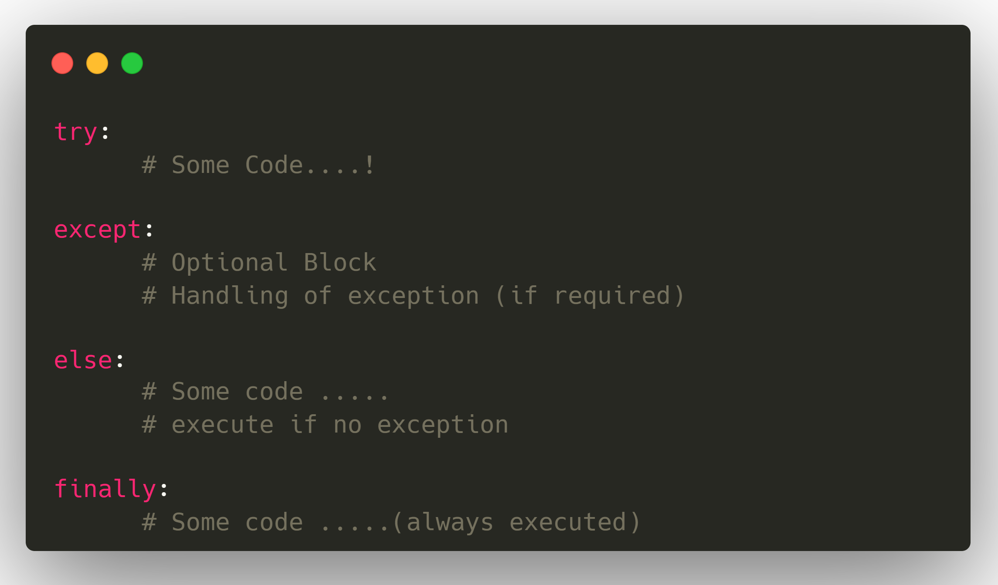
22. How Exception Handled in Python ?
Try: This block will test the exceptional error to occur.
Except: Here you can handle the error.
Else: If there is no exception then this block will be executed.
Finally: Finally block always gets executed either exception is generated or not.

Slide 24
23. Difference between Python 2.0 & Python 3.0 ?
Basis of comparison | Python 3 | Python 2
Syntax | def main(): print("Hello World!") if __name__== "__main__": main() | def main(): print "Hello World!" if __name__== "__main__": main()
Release Date | 2008 | 2000
Function print | print (“hello”) | print “hello”
Division of Integers | Whenever two integers are divided, you get a float value | When two integers are divided, you always provide integer value.
Unicode | In Python 3, default storing of strings is Unicode. | To store Unicode string value, you require to define them with “u”.
Syntax | The syntax is simpler and easily understandable. | The syntax of Python 2 was comparatively difficult to understand.

Slide 25
23. Difference between Python 2.0 & Python 3.0 ?
Basis of comparison | Python 3 | Python 2
Rules of ordering Comparisons | In this version, Rules of ordering comparisons have been simplified. | Rules of ordering comparison are very complex.
Iteration | The new Range() function introduced to perform iterations. | In Python 2, the xrange() is used for iterations.
Exceptions | It should be enclosed in parenthesis. | It should be enclosed in notations.
Leak of variables | The value of variables never changes. | The value of the global variable will change while using it inside for-loop.
Backward compatibility | Not difficult to port python 2 to python 3 but it is never reliable. | Python version 3 is not backwardly compatible with Python 2.
Library | Many recent developers are creating libraries which you can only use with Python 3. | Many older libraries created for Python 2 is not forward-compatible.

Slide 26
24. What is ‘PIP’ in Python ?
PIP in Python stands for "Pip Installs Packages" (or sometimes "Pip Installs Python" in jokes). It’s the package manager for Python, used to install, upgrade, and manage third-party libraries.
Key Points about PIP
Purpose: Download and install Python packages from the Python Package Index (PyPI) or other indexes.
Included: Comes pre-installed with modern versions of Python (≥ 3.4).
Command-line tool: You run it in the terminal/command prompt.
Command | Description
pip install package_name | Install a package
pip uninstall package_name | Remove a package
pip list | Show all installed packages
pip show package_name | Show details about a package
pip install package==version | Install a specific version
pip install --upgrade package | Upgrade a package
pip freeze > requirements.txt | Export installed packages
pip install -r requirements.txt | Install from a requirements file

Slide 27
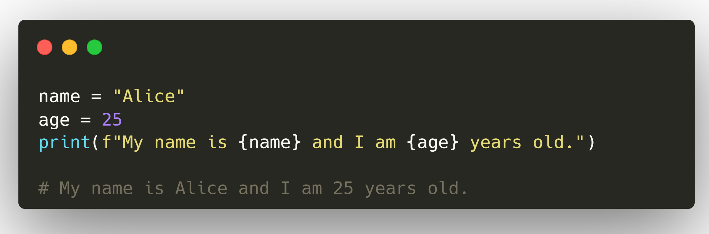
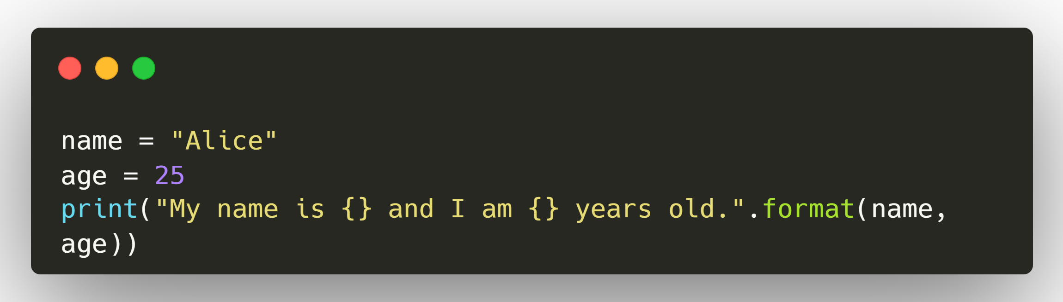
25. How to use F String and Format or Replacement Operator ?
1. F-Strings (Python 3.6+)
Syntax: Prefix your string with f and use {} to insert variables or expressions.
Fast and readable.
2. str.format() Method (Python 2.7+ / 3.0+)
Uses {} placeholders and replaces them with .format() arguments.
3. Replacement Operator {} in Old % Formatting (Legacy)
This is the old style from Python 2, still works in Python 3 but not recommended for new code.

Slide 28
26. Difference between Abstraction and Encapsulation ?
Abstraction | Encapsulation
Abstraction works on the design level. | Encapsulation works on the application level.
Abstraction is implemented to hide unnecessary data and withdrawing relevant data. | Encapsulation is the mechanism of hiding the code and the data together from the outside world or misuse.
It highlights what the work of an object instead of how the object works is | It focuses on the inner details of how the object works. Modifications can be done later to the settings.
Abstraction focuses on outside viewing, for example, shifting the car. | Encapsulation focuses on internal working or inner viewing, for example, the production of the car.
Abstraction is supported in Java with the interface and the abstract class. | Encapsulation is supported using, e.g. public, private and secure access modification systems.
In a nutshell, abstraction is hiding implementation with the help of an interface and an abstract class. | In a nutshell, encapsulation is hiding the data with the help of getters and setters.

Slide 29
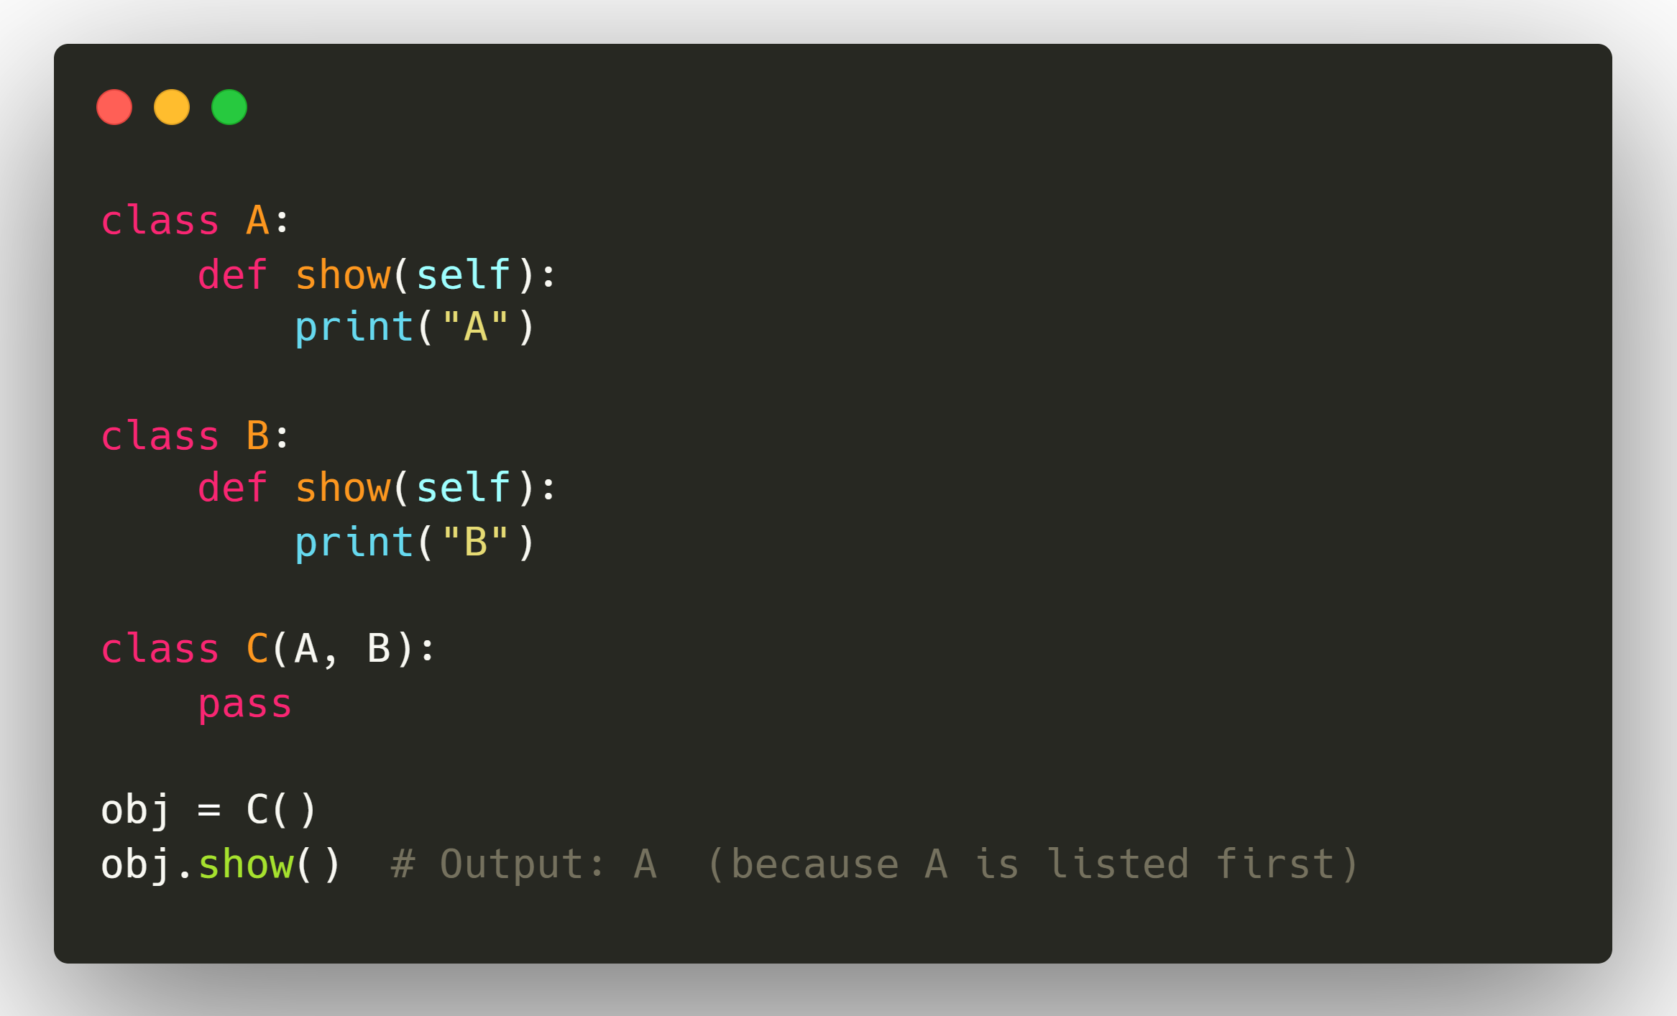
27. Does Python Support Multiple Inheritance (Diamond Problem) ?
Yes, Python supports multiple inheritance, meaning a class can inherit from more than one parent class.
But when multiple inheritance forms a diamond shape, we get what’s called the Diamond Problem and Python solves it using Method Resolution Order (MRO).

Slide 30
28. Difference Between .py and .pyc
1. .py files
Meaning: Python source code files you write.
Content: Human-readable code in plain text.
Execution: When you run a .py file, Python compiles it into bytecode automatically before execution.
Example:
print("Hello, World!")
2. .pyc files
Meaning: Compiled Python bytecode files.
Content: Not human-readable — optimized, lower-level instructions for the Python Virtual Machine (PVM).
Location: Stored in the __pycache__ folder by default.
Purpose: Speeds up program startup by skipping recompilation if the .py file hasn’t changed.
Creation: Generated automatically when a .py file is run, unless disabled.

Slide 31
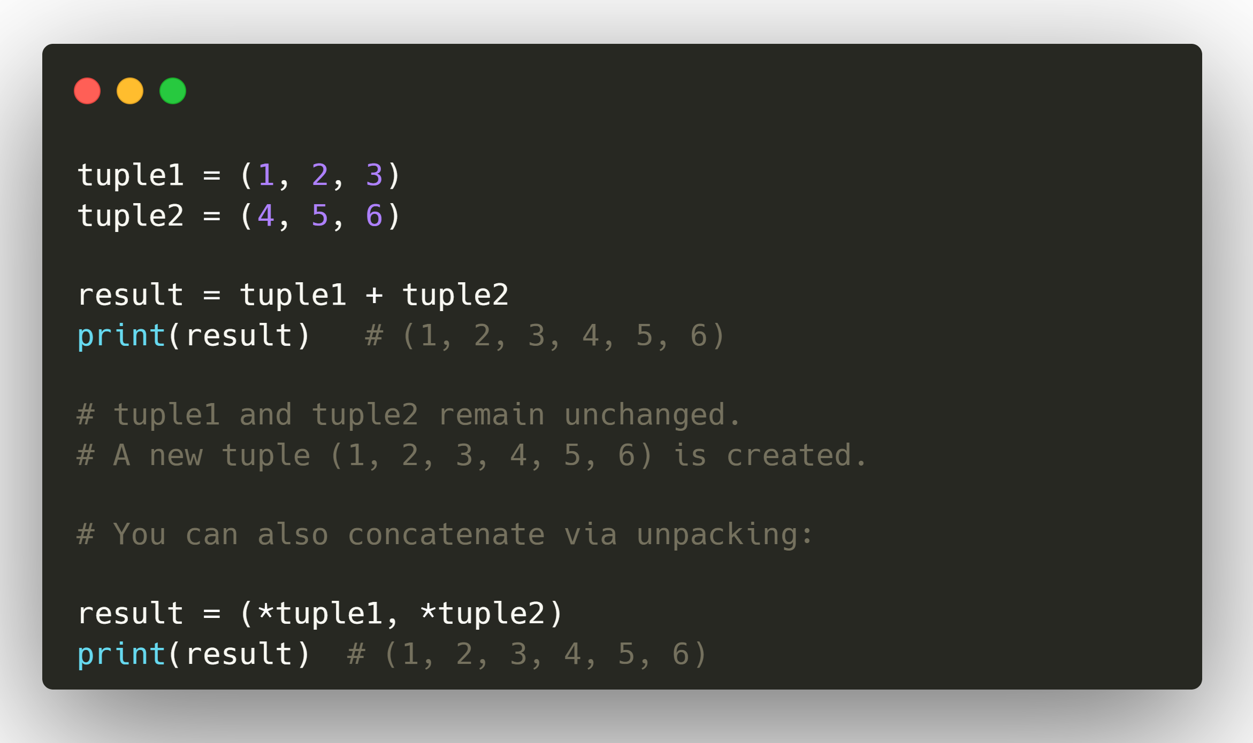
29. Can you Concatenate Two Tuples ? If Yes, How is it Possible? Since it is Immutable ?
Yes, you can concatenate two tuples in Python even though tuples are immutable.
How It Works
Immutable means: You cannot change an existing tuple’s elements in place.
But concatenation creates a new tuple by combining the elements of both it doesn’t modify either original tuple.
Why It Doesn’t Break Immutability
Immutability forbids altering existing data.
Concatenation uses the + operator to construct a brand-new object in memory.
The original tuples are untouched.

Slide 32
30. What is _a, __a, __a__ in Python ?
_a
Python doesn't have real private methods, so one underline in the beginning of a variable/function/method name means it's a private variable/function/method and It is for internal use only
We also call it weak Private
__a
Leading double underscore tell python interpreter to rewrite name in order to avoid conflict in subclass.
Interpreter changes variable name with class extension and that feature known as the Mangling.
In Mangling python interpreter modify variable name with __.
So Multiple time It use as the Private member because another class can not access that variable directly.
Main purpose for __ is to use variable/method in class only If you want to use it outside of the class you can make public api.
__a__
Name with start with __ and ends with same considers special methods in Python.
Python provide this methods to use it as the operator overloading depending on the user.
Python provides this convention to differentiate between the user defined function with the module’s function

Slide 33
31. Difference between Anonymous and Lambda Function ?
Anonymous Function
Meaning: A function without a name.
In Python, lambda functions are one way to create anonymous functions.
“Anonymous” is a concept, not a syntax — it means the function is not bound to an identifier (variable).
Example: print((lambda x: x * 2)(5)) # No name given, directly executed → 10
2. Lambda Function
Meaning: A specific syntax in Python for creating small, anonymous functions in one line.
Created using the lambda keyword.
Syntax:
double = lambda x: x * 2
print(double(5)) # 10

Slide 34
32. What is GIL. Explain
The Global Interpreter Lock (GIL) of Python allows only one thread to be executed at a time. It is often a hurdle, as it does not allow multi-threading in python to save time
The Python Global Interpreter Lock or GIL, in simple words, is a mutex (or a lock) that allows only one thread to hold the control of the Python interpreter.
This means that only one thread can be in a state of execution at any point in time. The impact of the GIL isn’t visible to developers who execute single-threaded programs, but it can be a performance bottleneck in CPU-bound and multi-threaded code.
Since the GIL allows only one thread to execute at a time even in a multi-threaded architecture with more than one CPU core, the GIL has gained a reputation as an “infamous” feature of Python.
Basically, GIL in Python doesn’t allow multi-threading which can sometimes be considered as a disadvantage.

Slide 35
33. Explain Namespace and Its Types ?
Namespace:
In python we deal with variables, functions, libraries and modules etc.
There is a chance the name of the variable you are going to use is already existing as name of another variable or as the name of another function or another method.
In such scenario, we need to learn about how all these names are managed by a python program. This is the concept of namespace.
Categories Of Namespace: Following are the three categories of namespace
Local Namespace: All the names of the functions and variables declared by a program are held in this namespace. This namespace exists as long as the program runs.
Global Namespace: This namespace holds all the names of functions and other variables that are included in the modules being used in the python program. It includes all the names that are part of the Local namespace.
Built-in Namespace: This is the highest level of namespace which is available with default names available as part of the python interpreter that is loaded as the programing environment. It include Global Namespace which in turn include the local namespace.
We can access all the names defined in the built-in namespace as follows.
builtin_names = dir(__builtins__)
for name in builtin_names:
print(name)

Slide 36
34. What are Unittests in Python ?
Unit Testing is the first level of software testing where the smallest testable parts of a software are tested. This is used to validate that each unit of the software performs as designed. The unittest test framework is python's xUnit style framework. This is how you can import it.
import unittest
Unit testing is a software testing method by which individual units of source code are put under various tests to determine whether they are fit for use (Source). It determines and ascertains the quality of your code.
Generally, when the development process is complete, the developer codes criteria, or the results that are known to be potentially practical and useful, into the test script to verify a particular unit's correctness. During test case execution, various frameworks log tests that fail any criterion and report them in a summary.
The developers are expected to write automated test scripts, which ensures that each and every section or a unit meets its design and behaves as expected.
Though writing manual tests for your code is definitely a tedious and time-consuming task, Python's built-in unit testing framework has made life a lot easier.
The unit test framework in Python is called unittest, which comes packaged with Python.
Unit testing makes your code future proof since you anticipate the cases where your code could potentially fail or produce a bug. Though you cannot predict all of the cases, you still address most of them.

Slide 37
35. How to use Map, Filter and Reduce Function in Python ?
Map() Function
The map() function iterates through all items in the given iterable and executes the function we passed as an argument on each of them.
The syntax is:
map(function, iterable(s))
fruit = ["Apple", "Banana", "Pear"]
map_object = map(lambda s: s[0] == "A", fruit)
print(list(map_object))
Output:
[True, False, False]
Filter() Function
The filter() function takes a function object and an iterable and creates a new list.
As the name suggests, filter() forms a new list that contains only elements that satisfy a certain condition, i.e. the function we passed returns True.
The syntax is:
filter(function, iterable(s))
fruit = ["Apple", "Banana", " Apricot"]
filter_object = filter(lambda s: s[0] == "A", fruit)
print(list(filter_object))
Output:
['Apple', 'Apricot']
Reduce() Function
The reduce() Function works differently than map() and filter(). It does not return a new list based on the function and iterable we've passed. Instead, it returns a single value.
Also, in Python 3 reduce() isn't a built-in function anymore, and it can be found in the functools module.
The syntax is:
reduce(function, sequence[, initial])
from functools import reduce
list = [2, 4, 7, 3]
print(reduce(lambda x, y: x + y, list))
print("With an initial value: " + str(reduce(lambda x, y: x + y, list, 10)))
Output:
16
With an initial value: 26

Slide 38
36. Difference between Shallow Copy and Deep Copy?
Shallow Copy:
Shallow copies duplicate as little as possible. A shallow copy of a collection is a copy of the collection structure, not the elements. With a shallow copy, two collections now share the individual elements.
Shallow copying is creating a new object and then copying the non static fields of the current object to the new object. If the field is a value type, a bit by bit copy of the field is performed. If the field is a reference type, the reference is copied but the referred object is not, therefore the original object and its clone refer to the same object.
Deep Copy:
Deep copies duplicate everything. A deep copy of a collection is two collections with all of the elements in the original collection duplicated.
Deep copy is creating a new object and then copying the non-static fields of the current object to the new object. If a field is a value type, a bit by bit copy of the field is performed. If a field is a reference type, a new copy of the referred object is performed. A deep copy of an object is a new object with entirely new instance variables, it does not share objects with the old. While performing Deep Copy the classes to be cloned must be flagged as [Serializable].

Slide 39
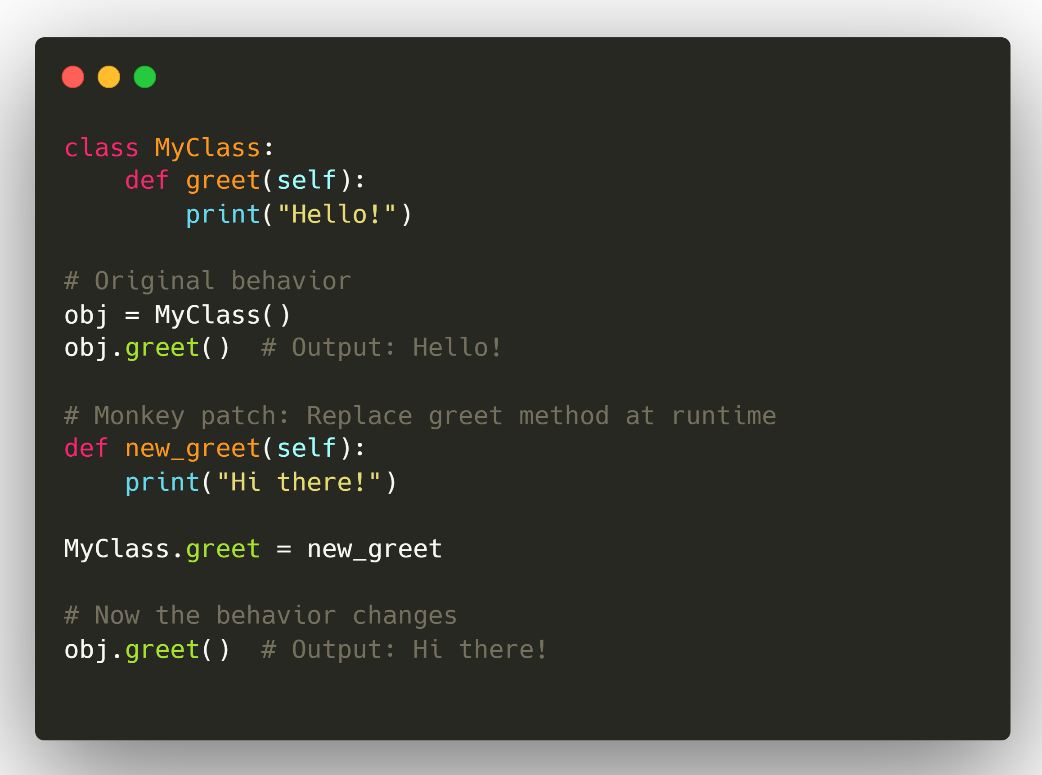
37. What does MONKEY PATCHING refer to in python?
In Python, monkey patching means modifying or extending code at runtime without changing the original source code usually by replacing methods, attributes, or classes dynamically.
Key Points
Done at runtime (while the program is running).
Often used to fix bugs, add features, or change behavior in libraries you can’t modify directly.
Works because Python is highly dynamic — classes and functions can be reassigned on the fly.
Common Uses
Testing: Mocking certain methods (e.g., network calls) without touching the original code.
Patching bugs in third-party libraries until an official fix is released.
Dynamic feature injection for plugins.
Risks
Can make code hard to read and debug.
May cause unexpected side effects if multiple patches interfere.
If the library updates, your patch might break.

Slide 40
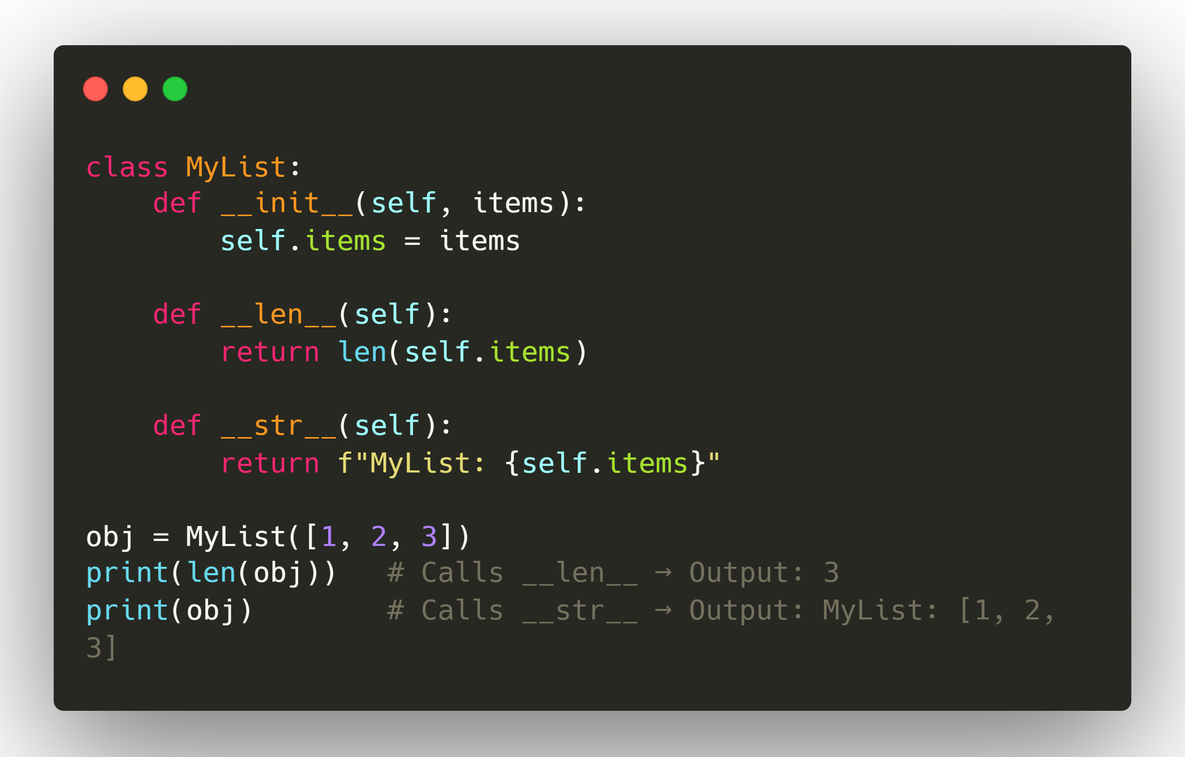
38. What is Dunder Method ?
Meaning: “Double Underscore” methods — special methods with names like __init__, __len__, __str__.
Also called magic methods or special methods.
Python uses them to implement built-in behaviors and operator overloading.
Examples:
__init__ → constructor
__str__ → string representation
__len__ → length of an object
__eq__ → equality (==)
__add__ → addition (+)

Slide 41
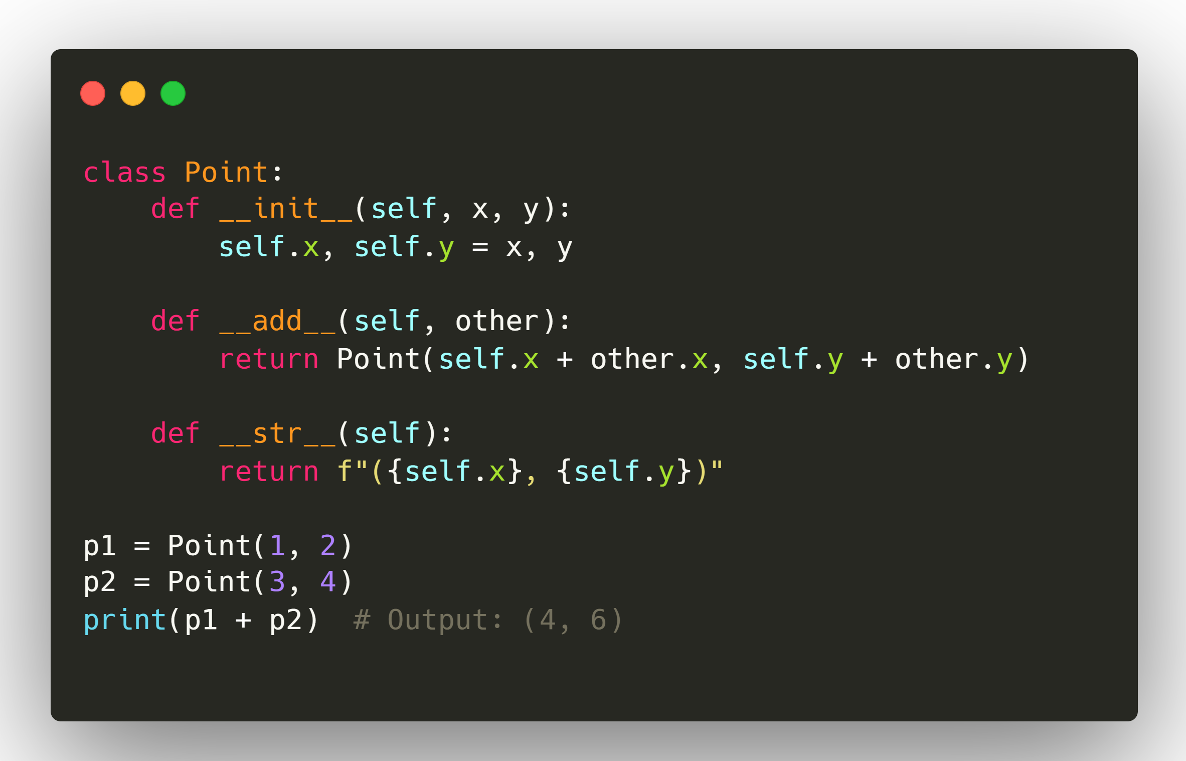
39. What is Operator Overloading ?
Meaning: Giving a custom meaning to Python’s built-in operators (+, -, *, ==, etc.) for your own classes.
Instead of using the operator’s default behavior, you define special methods to make it work with your objects.
 | Operator Overloading | Dunder Method
Definition | Customizing operators for user-defined classes | Special double-underscore methods Python calls for specific operations
Relation | Implemented using dunder methods (__add__, __eq__, etc.) | Broader — covers object lifecycle, representation, and more
Example | __add__ to overload + | __init__, __str__, __len__

Slide 42
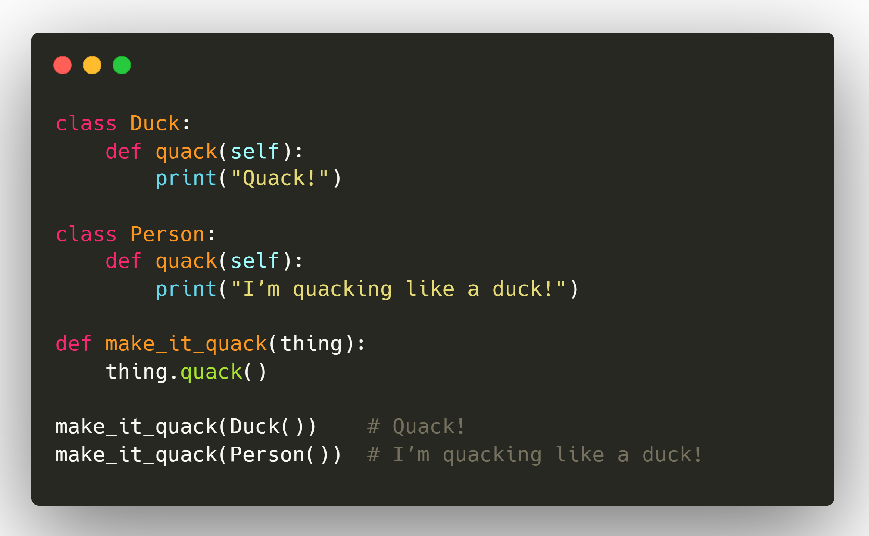
40. Why Python is called Dynamic Typed Language or what is Duck Typing ?
Python is Dynamic typed as it determines the type of a variable at runtime, and variables can change type during execution.
Duck typing means Python cares more about an object’s behavior (methods and properties) than its actual type.
Dynamically Typed: In Python, you don’t declare variable types explicitly. The interpreter figures out the type at runtime based on the value assigned. Ex
x = 10 # x is int
x = "Hello" # x is now str
NOTE: The "Duck typing" name comes from the phrase, “If it walks like a duck and it quacks like a duck, then it must be a duck.”
Python don't have any problem even if we don't declare the type of variable.
It states the kind of variable in the runtime of the program.
Python also take cares of the memory management which is crucial in programming. So, Python is a dynamically typed language.

Slide 43
41. Why Python is called an Interpreted Language ?
Interpreted simply means your code run line by line. While in compiled language whole program compiled at once.
In compilation, source code is first converted to object code and then to the machine code.
You can see that in a compiled language your whole program compiled at once and give the output.
But in interpreted language, every single line is converted to machine code directly. That's why Python is very slow, because it interpret one line at a time.
You have seen that if, you run code in Python and do any mistake at the bottom of your python code. And you execute the code then it will give you output till the correct code part and the remaining part gives the error in a console window where you do the error. Because the interpreted language executes line by line instead of executing the whole program at once.
But, the same thing in a compiled language you always get the error. Your whole code must be correct for the execution of the program.

Slide 44
42. Is Python a Fully Object Oriented Language ?
No, Python is not fully object-oriented, but it supports object-oriented programming.
Explanation:
Python treats everything as an object (including numbers, strings, and functions), and it supports OOP concepts such as encapsulation, inheritance, and polymorphism.
However, Python is not purely object-oriented because it also supports procedural programming (writing functions without classes) and functional programming features (like map, filter, and lambda expressions).
In a fully object-oriented language (like Smalltalk), everything — even basic operations — must be performed through objects. In Python, you can mix object-oriented, procedural, and functional styles.
Key takeaway:
Python = multi-paradigm language → OOP + procedural + functional.
Not 100% OOP because it allows non-OOP code.

Slide 45
43. Difference between Static & Class Method ?
Class Method | Static Method
The class method takes cls (class) as first argument. | The static method does not take any specific parameter.
Class method can access and modify the class state. | Static Method cannot access or modify the class state.
The class method takes the class as parameter to know about the state of that class. | Static methods do not know about class state. These methods are used to do some utility tasks by taking some parameters.
@classmethod decorator is used here. | @staticmethod decorator is used here.

Slide 46
44. Multi-Processing Vs Multi-Threading
Feature | Multiprocessing | Multithreading
Definition | Runs multiple processes, each with its own Python interpreter and memory space. | Runs multiple threads within the same process and memory space.
Parallelism | Achieves true parallelism by bypassing the GIL (each process has its own GIL). | Limited by the GIL, only one thread runs Python bytecode at a time (but good for I/O-bound tasks).
Memory | Separate memory for each process. Data is not shared directly (needs IPC). | Shared memory, all threads can access same variables (needs locking to avoid race conditions).

Slide 47
44. Multi-Processing Vs Multi-Threading
Task Type | Better with Multiprocessing | Better with Multithreading
CPU-bound tasks (math-heavy, data crunching) | (Uses multiple CPU cores fully) | (GIL limits true parallelism)
I/O-bound tasks (network calls, file read/write) | (Process startup overhead) | (Threads can run while others wait for I/O)
Multiprocessing | Multithreading
✅ True parallelism | ✅ Lightweight & low overhead
✅ Utilizes multiple CPU cores | ✅ Good for I/O-bound work
❌ Higher memory usage (separate processes) | ❌ GIL limits CPU-bound parallelism
❌ Slower startup time | ❌ Needs locks to prevent data corruption

Slide 48
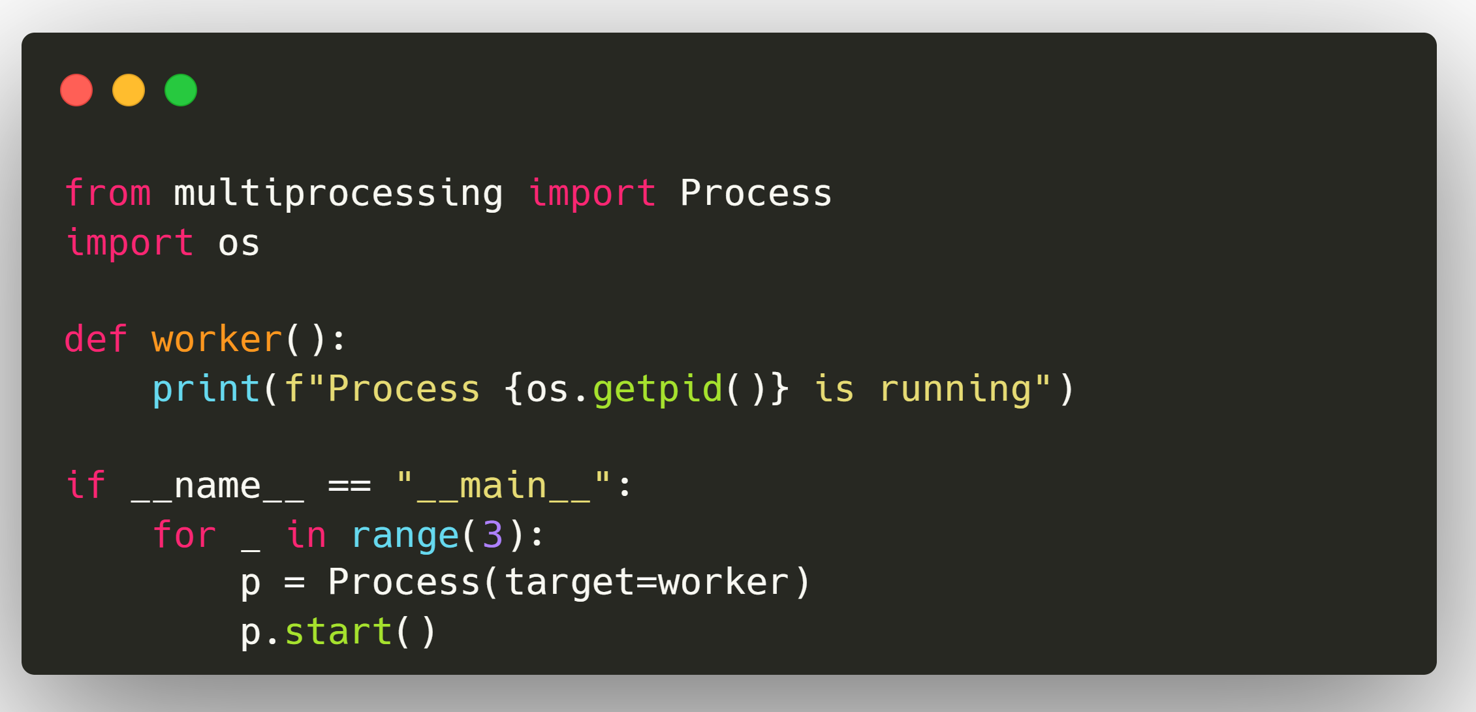
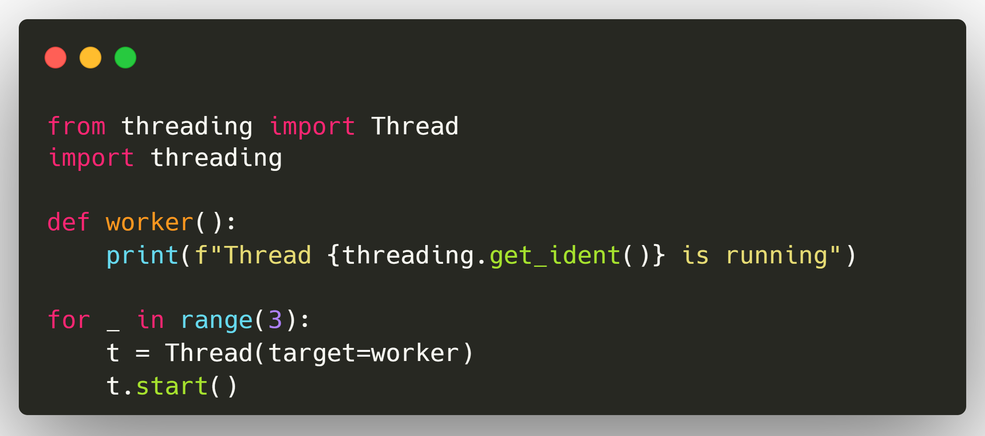
44. Multi-Processing Vs Multi-Threading
Each process has a separate Python interpreter and memory space.
All threads share the same memory space but are limited by the GIL.

Slide 49
Thank You
Congratulations! You have successfully completed this Python Interview Preparation course.
In this course, you have:
Mastered core Python concepts like data types, loops, functions, and OOP principles.
Explored advanced topics such as decorators, generators, dynamic typing, and Python’s object model.
Learned the key differences between static vs class methods, abstraction vs encapsulation, and more.
Practiced real interview-style questions that are frequently asked by top tech companies.

